Slide 1
Overview
Introduction- Sequential Circuit
Flip-Flops & Latches SR latch
Types of flip-flop
Master-slave flip-flop
Registers
Counters
Shift Registers

Slide 2
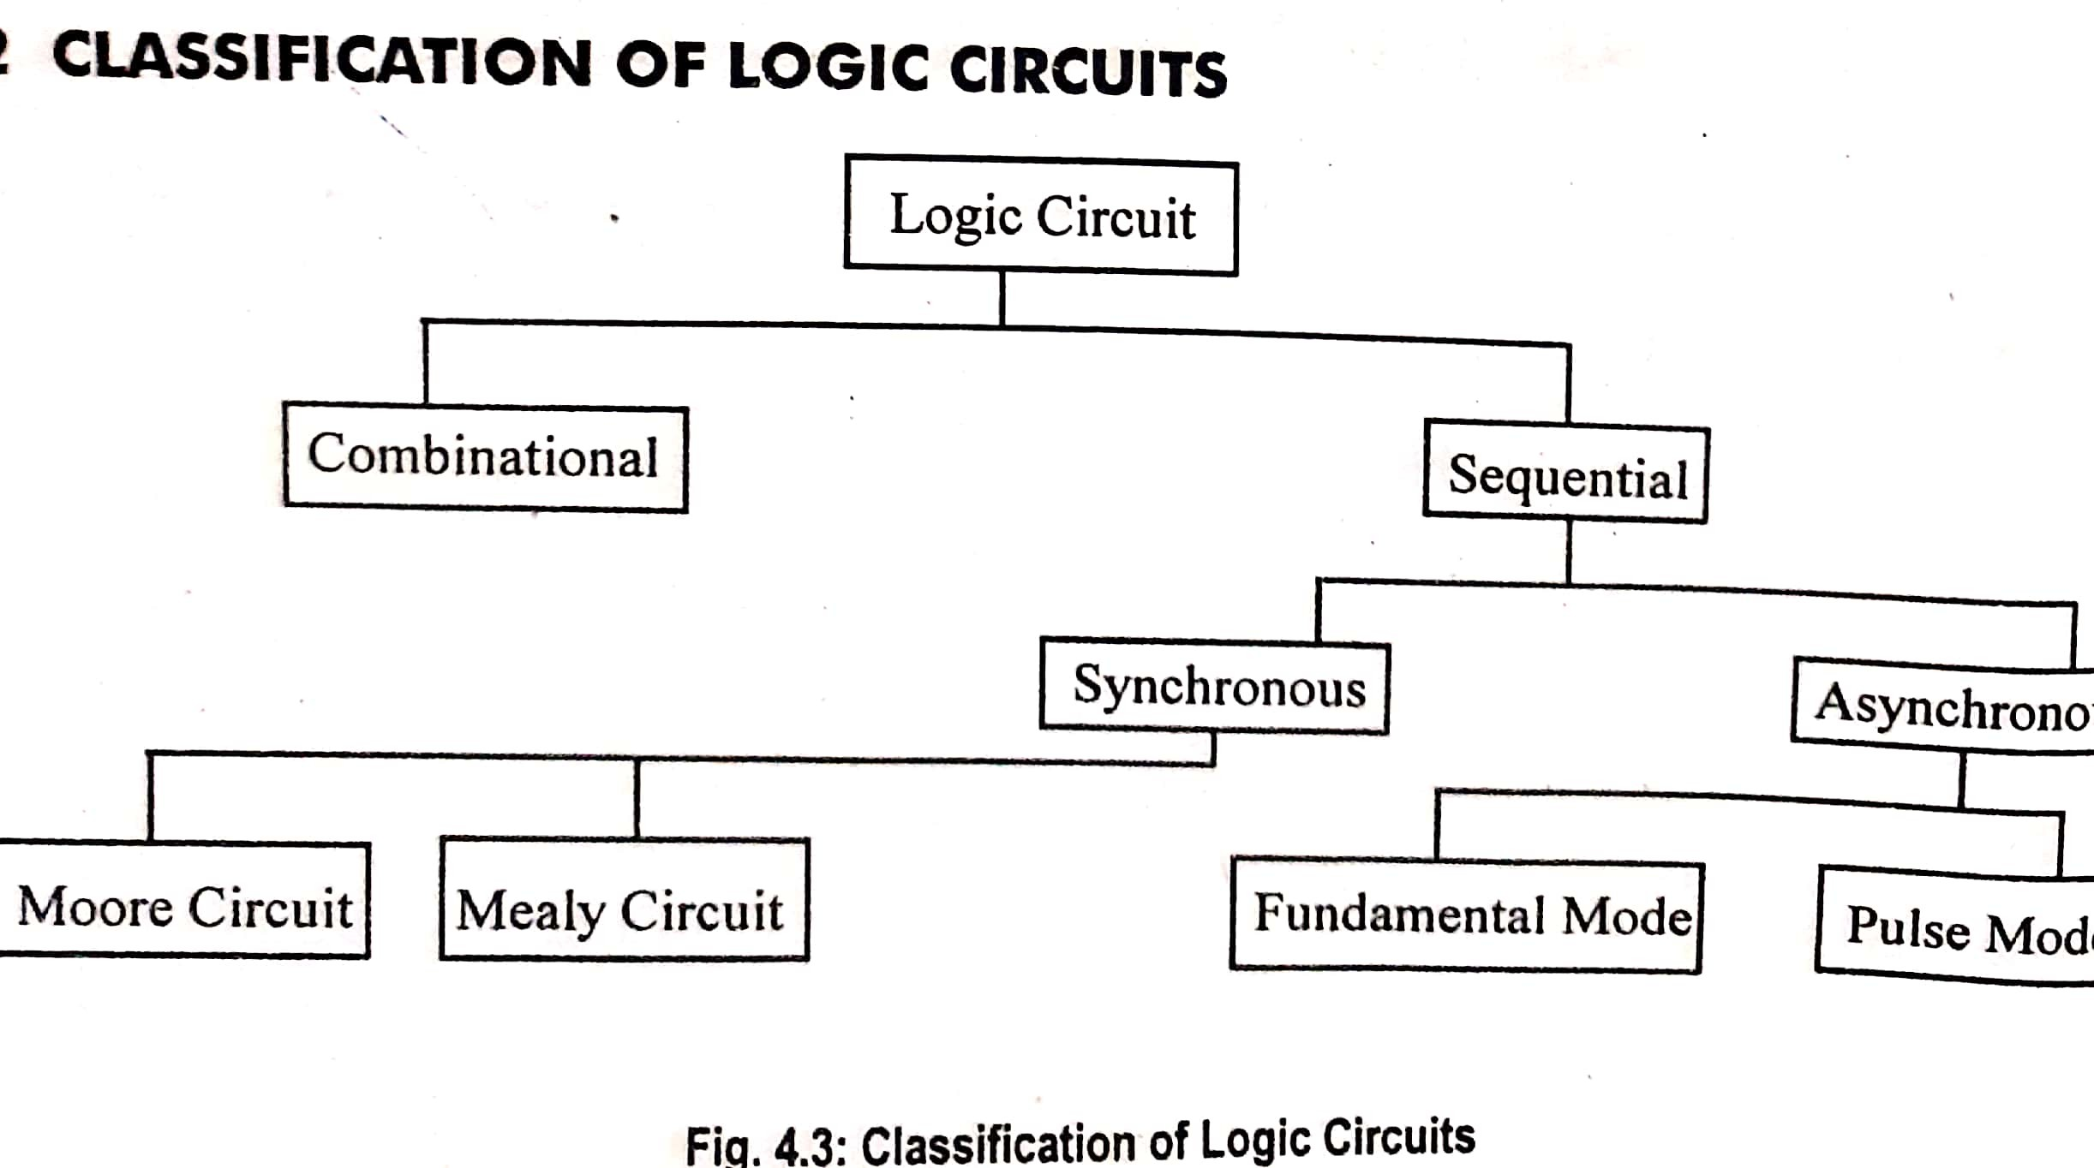

Slide 3
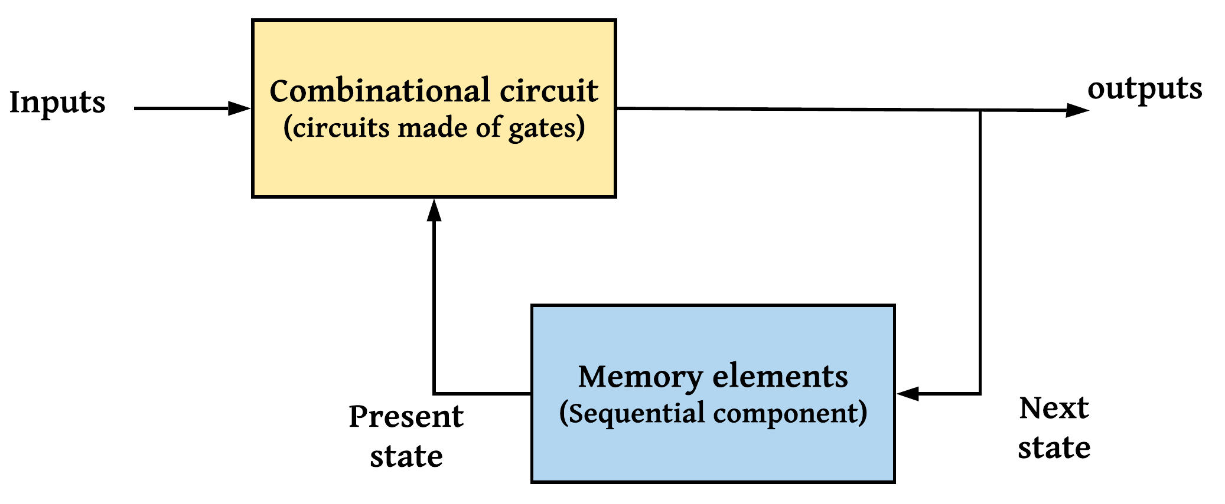
Introduction- Sequential Circuit
Fig.1. Block diagram of Sequential Circuits

Slide 4
Sequential Circuit (contd…)
Outputs in a sequential circuit are a function not only of the inputs, but also of the present state of the storage elements.
Next state of the storage elements is also a function of external inputs and the present state.
Sequential circuit is specified by a time sequence of inputs, outputs, and internal states .
In contrast, the outputs of combinational logic depend only on the present values of the inputs.

Slide 5
Sequential Circuit (contd…)
two types of sequential circuits - classification is a function of the timing of their signals
Synchronous sequential circuit is a system whose behaviour can be defined from the knowledge of its signals at discrete instants of time.
The behaviour of an asynchronous sequential circuit depends upon the input signals at any instant of time and the order in which the inputs change

Slide 6
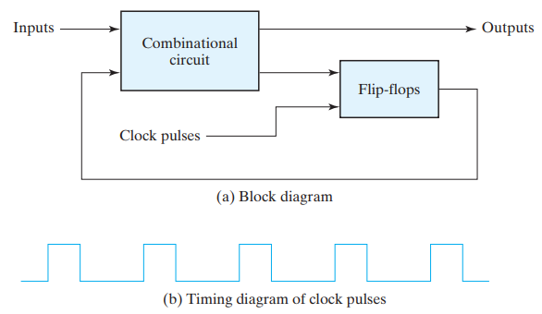
Synchronous clocked sequential circuit
Fig.2. Synchronous clocked sequential circuit

Slide 7
Storage Elements: Latches
Storage elements that operate with signal levels (rather than signal transitions) –latches
Latches are said to be level sensitive devices
latches are the basic circuits from which all flip-flops are constructed
Not practical for use as storage elements in synchronous sequential circuits

Slide 8
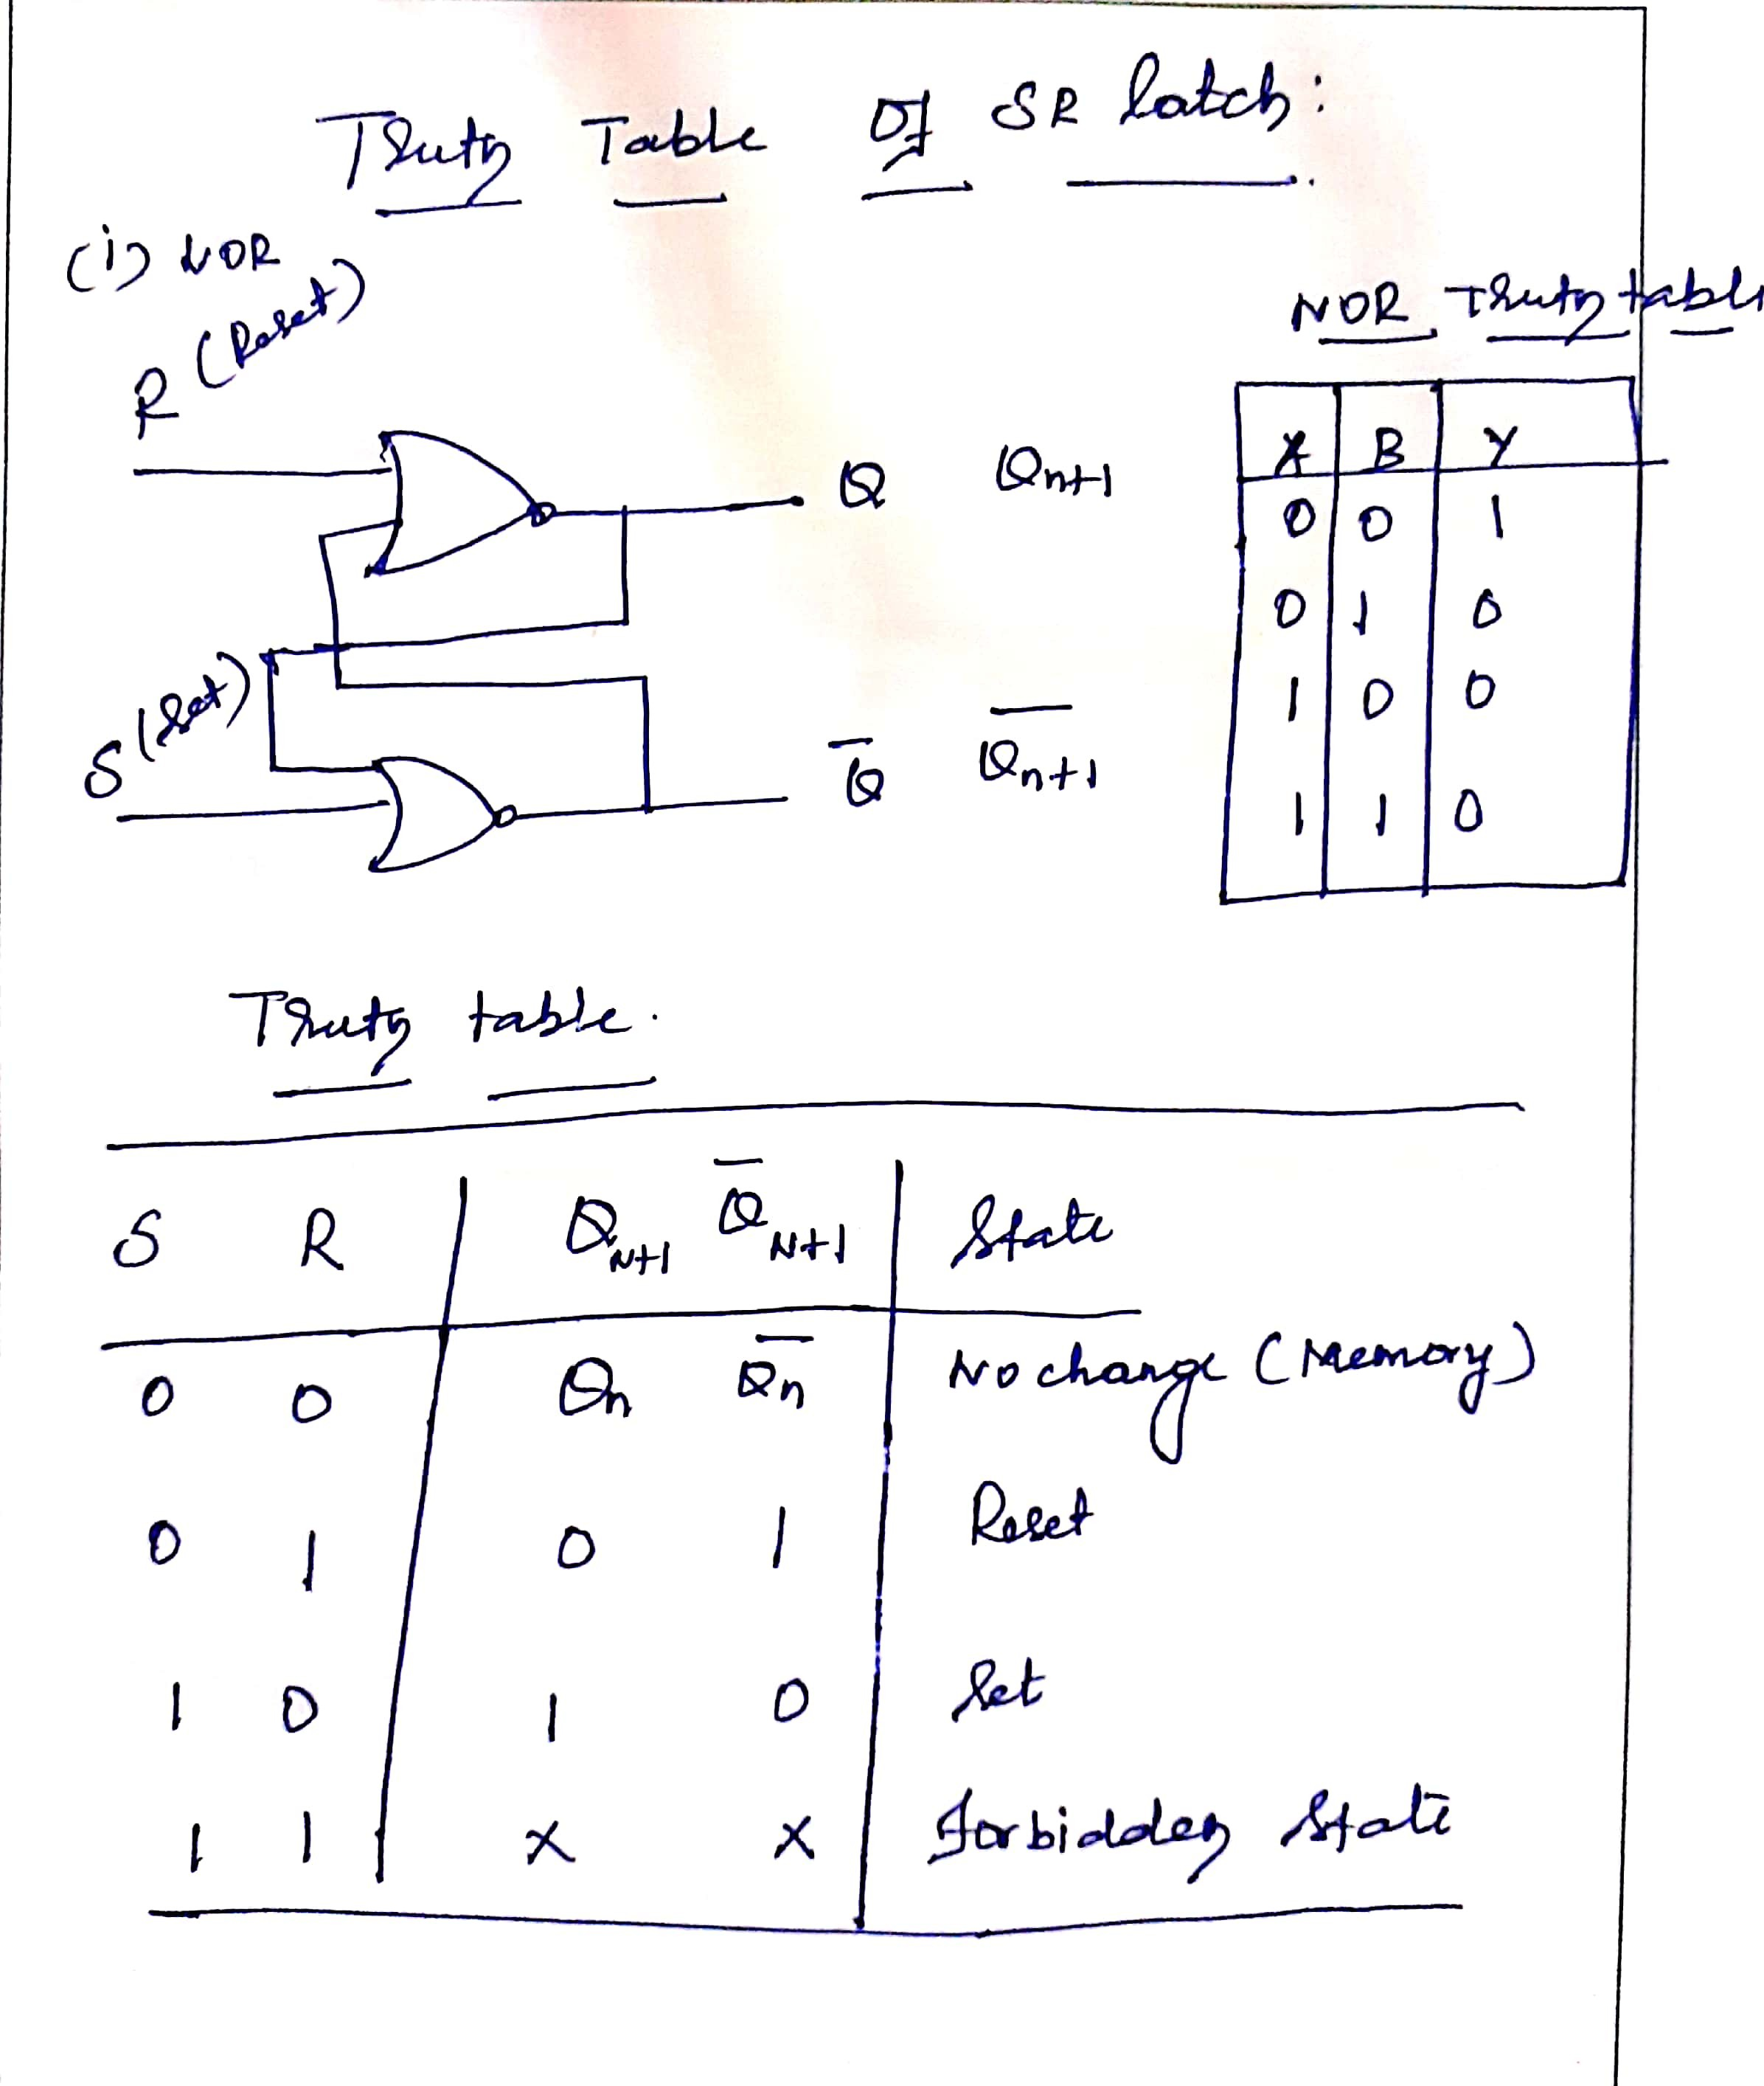

Slide 9
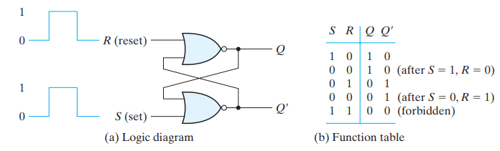
SR latch with NOR gates
SR latch constructed with two cross-coupled NOR gates
When output Q = 1 and Q’ = 0, the latch is said to be in the set state
When Q = 0 and Q’ = 1, , the latch is said to be in the reset state

Slide 10
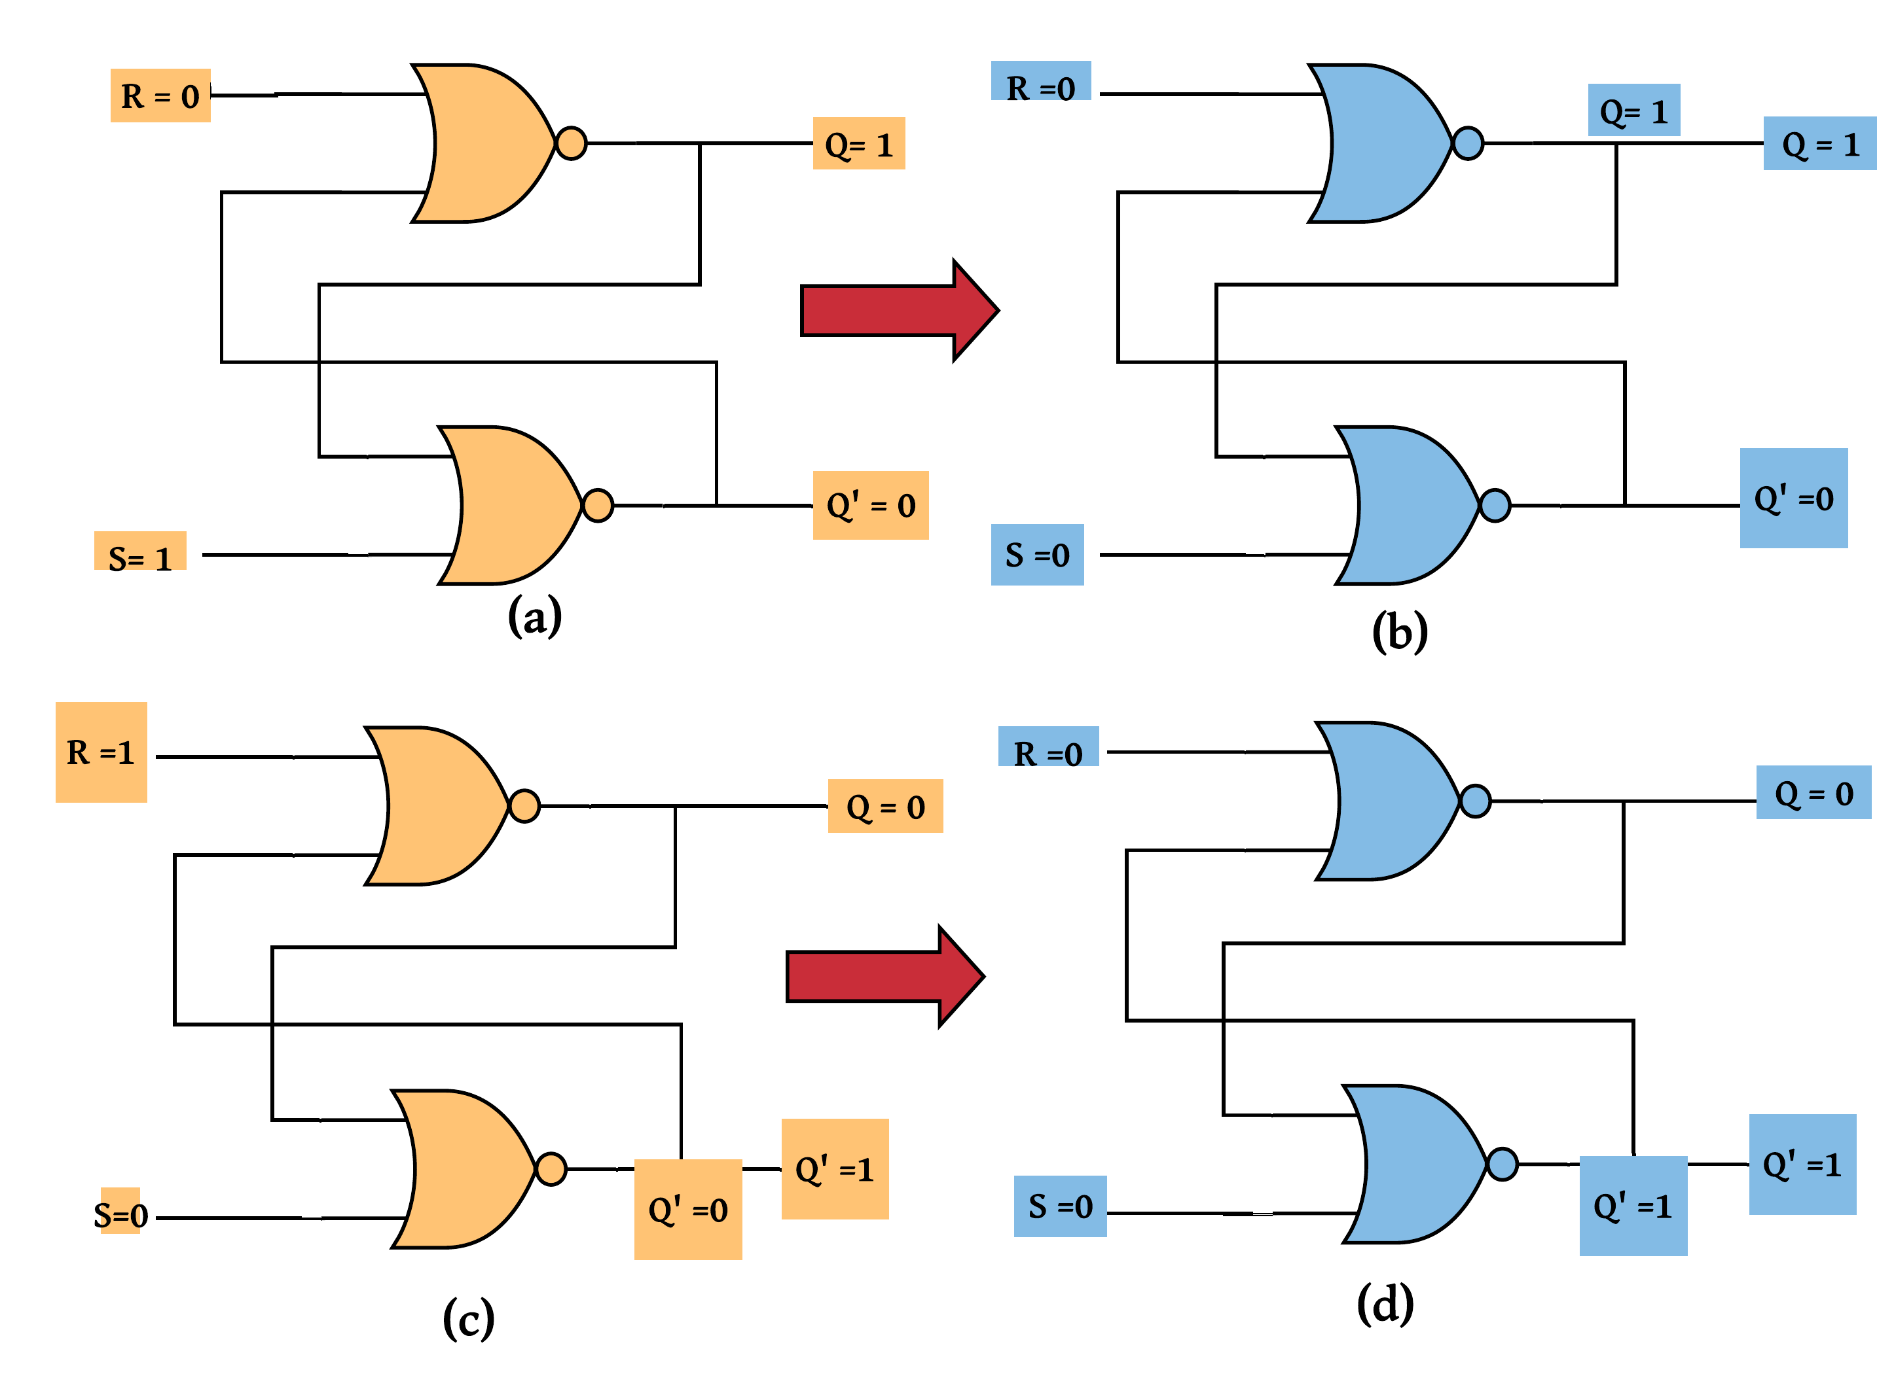
Latch
Operation
Figure 3: Characteristics of a SR Latch

Slide 11
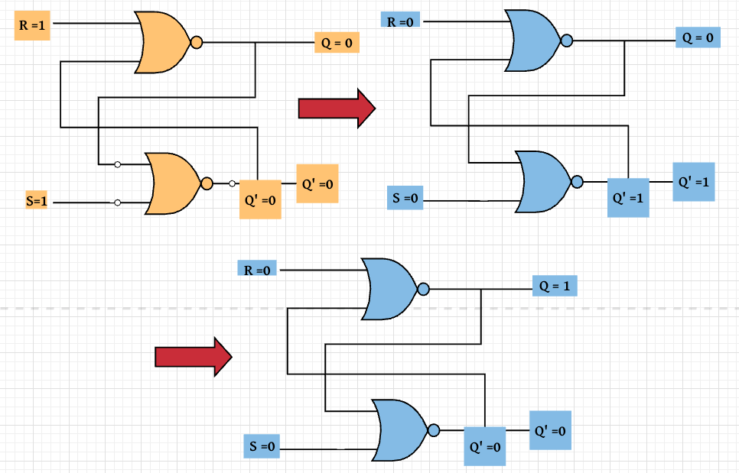
Latch
Operation contin..
Figure 4: Characteristics of a SR Latch
. . . . . . . . . . . . . . . . . . . .

Slide 12
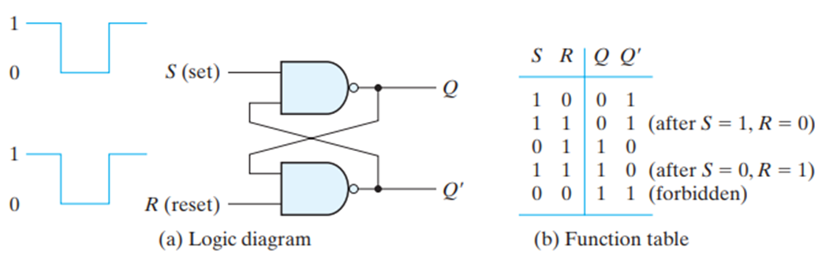
SR latch with NAND gates
In comparing the NAND with the NOR latch, note that the input signals for the NAND require the complement of those values used for the NOR latch.
Because the NAND latch requires a 0 signal to change its state, it is sometimes referred to as an S’R’ latch.

Slide 13
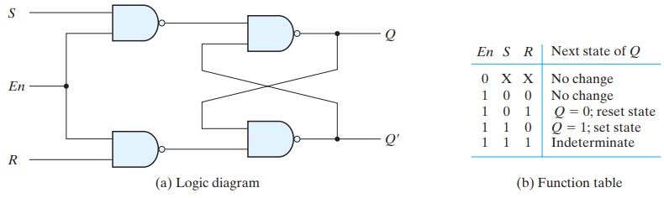
SR latch with control input
It consists of the basic SR latch and two additional NAND gates.
The control input En acts as an enable signal for the other two inputs.
The outputs of the NAND gates stay at the logic-1 level as long as the enable signal remains at 0
When the enable input goes to 1, information from the S or R input is allowed to affect the latch
Indeterminate condition makes this circuit difficult to manage

Slide 14
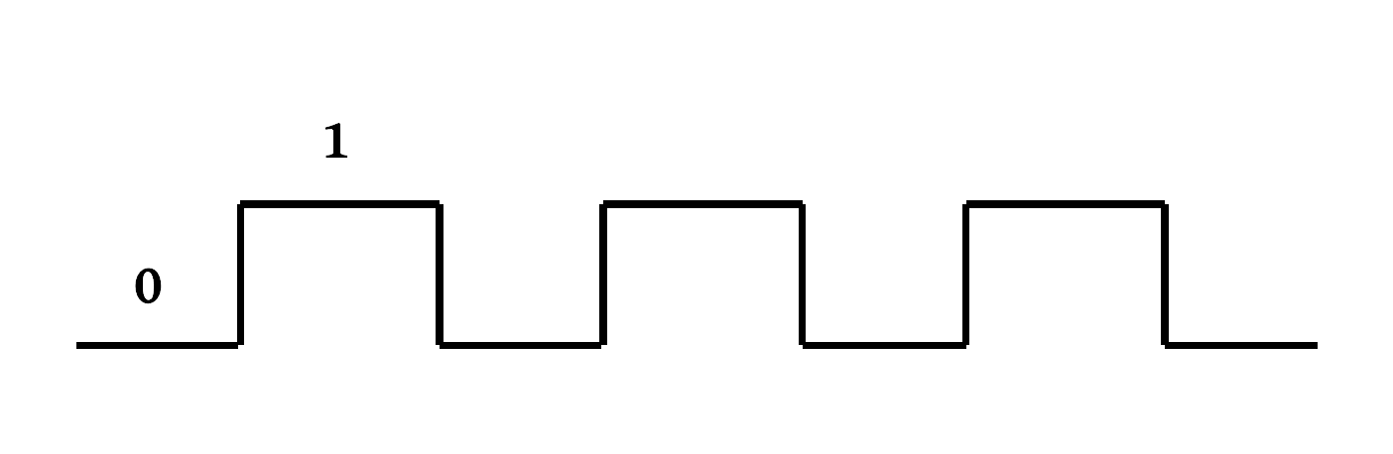
Clocks
Clocks
It controls the storage value.
It is a enable signal to decide when to take the new value of input and store in the latch.
Mostly, it is a square wave that goes either high to low or low to high.
Figure 6: Clock signal
Latches constructed using this clock signal are called as Flip-flops.
Types :
SR flip flop
D flip flop
T flip flop
- JK flip flop

Slide 15
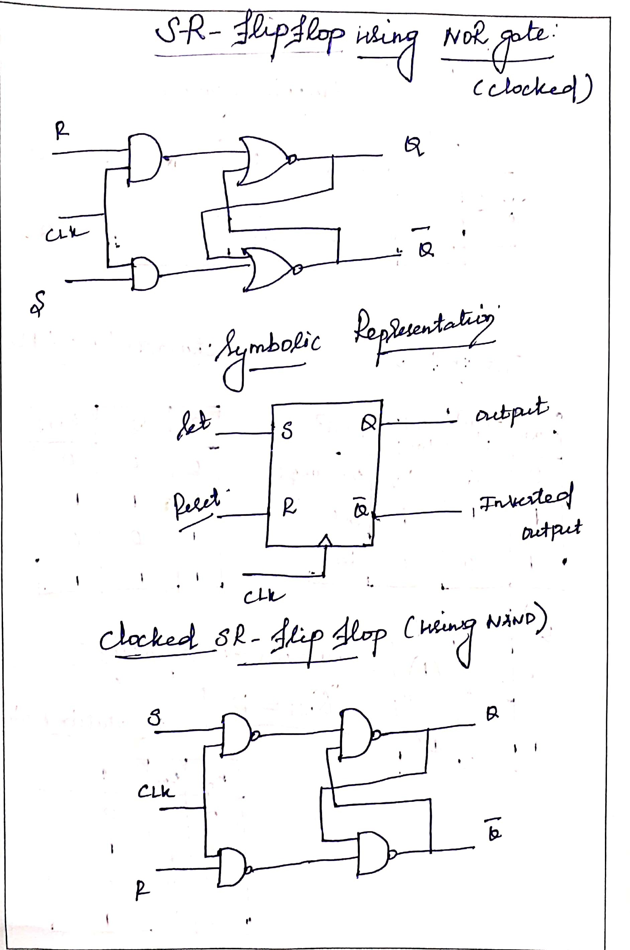

Slide 16
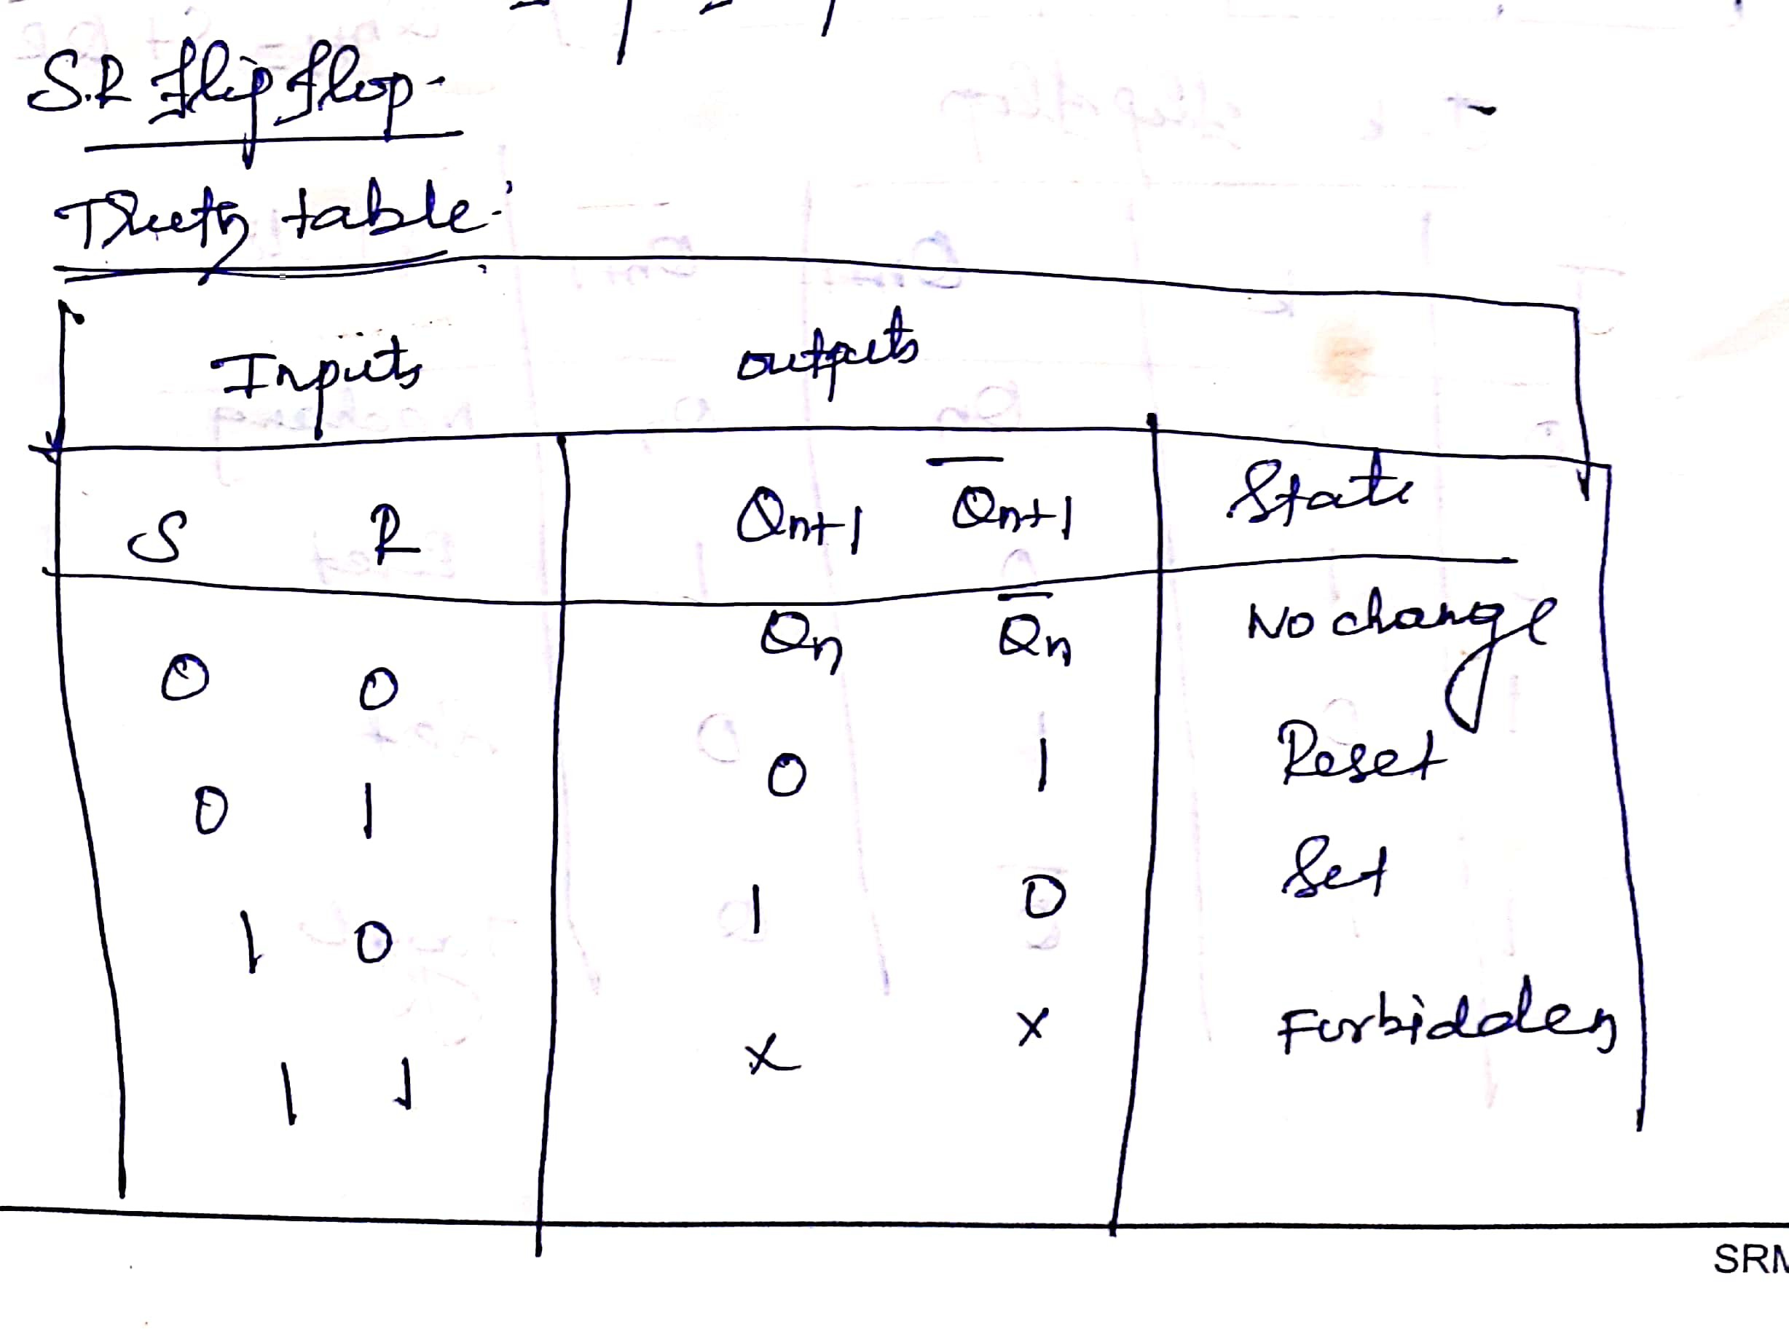

Slide 17
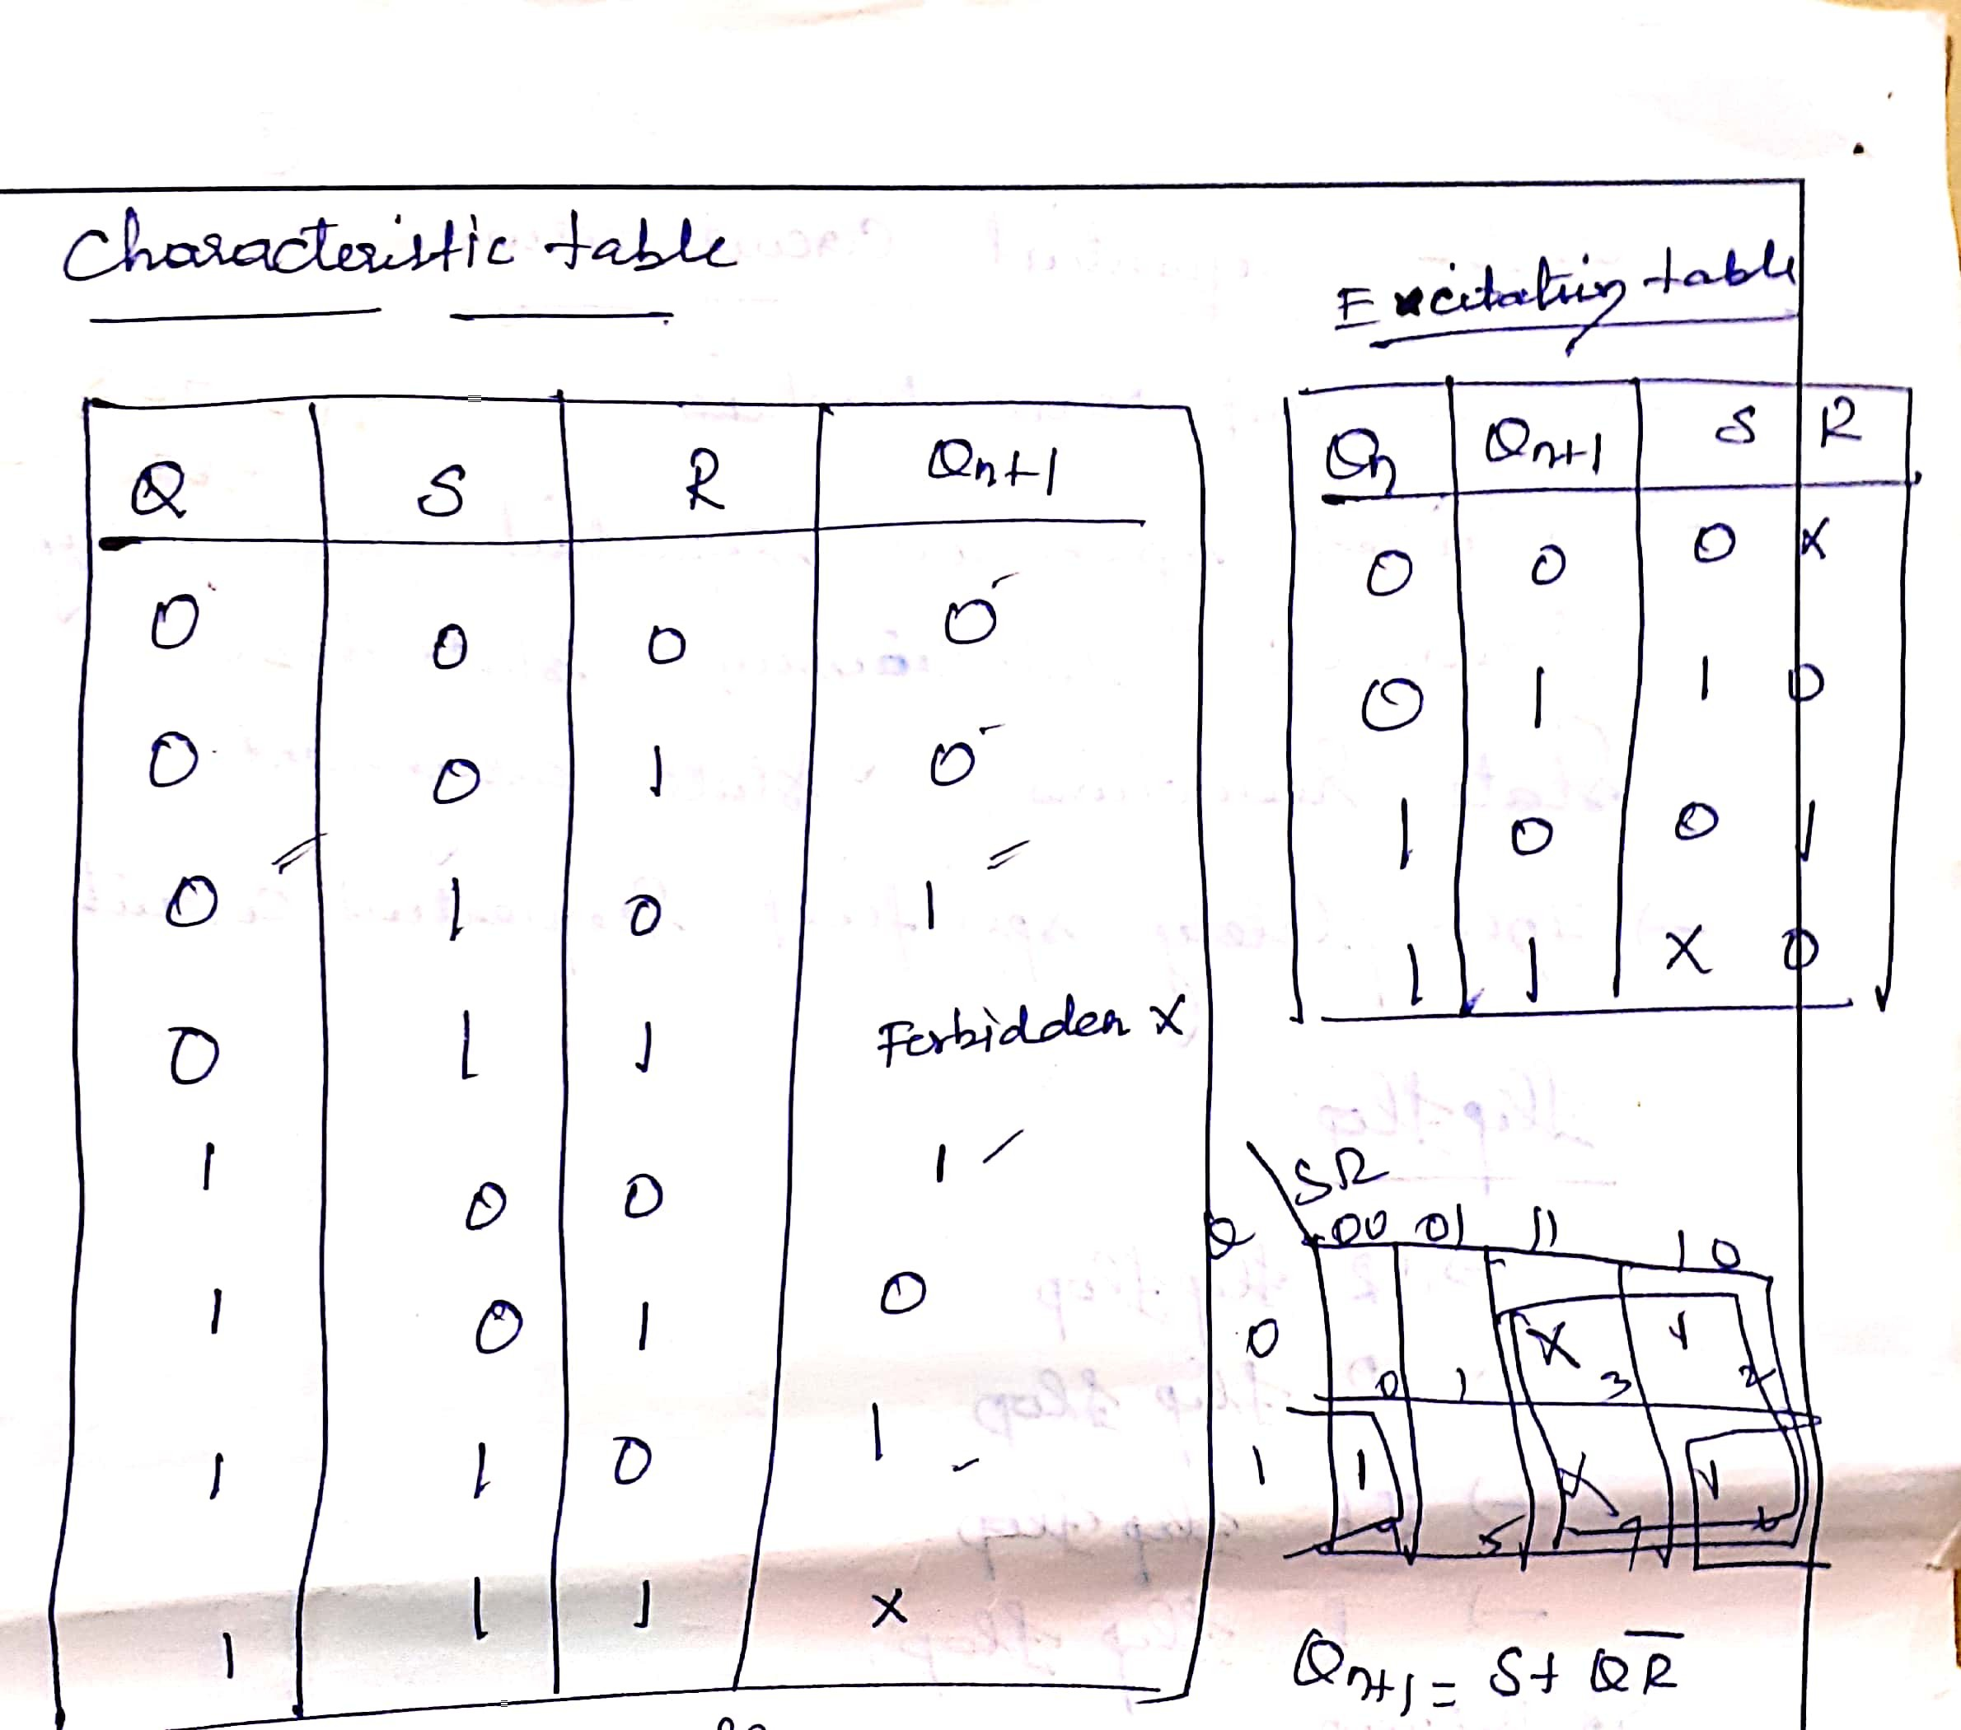

Slide 18
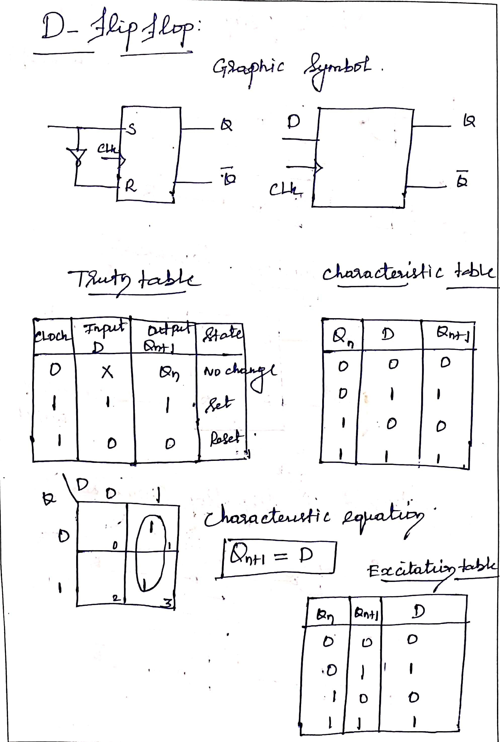

Slide 19
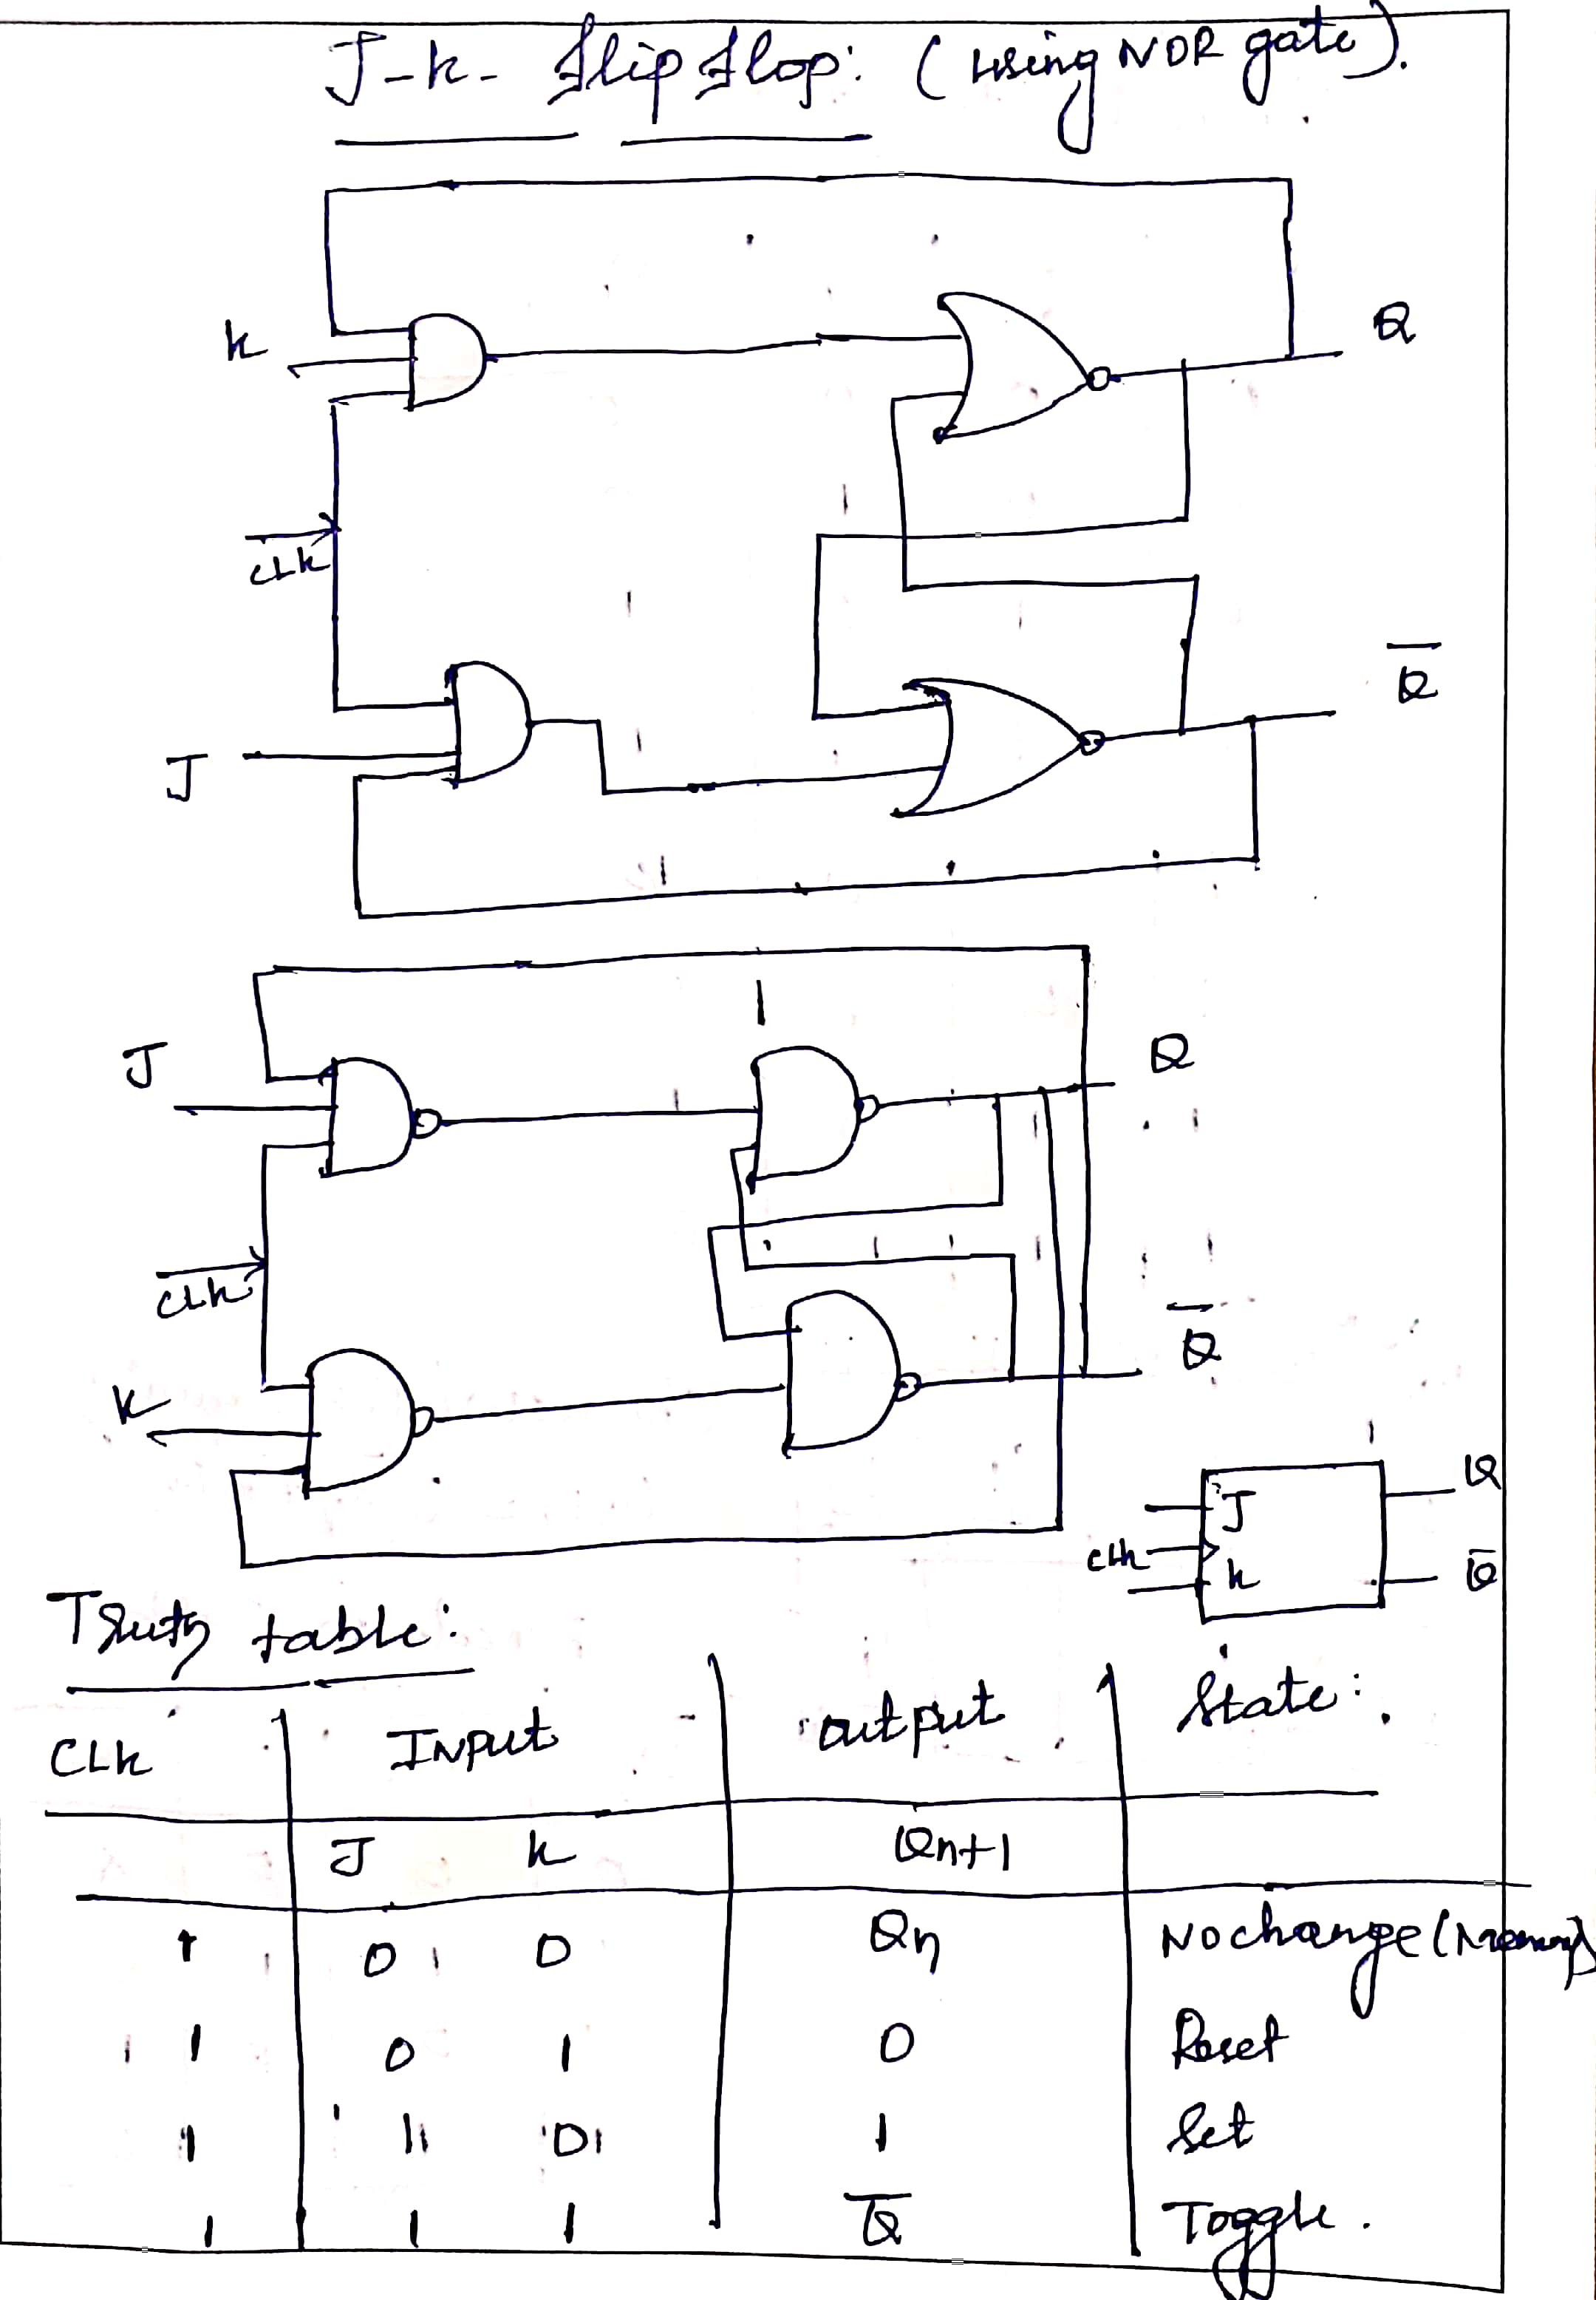

Slide 20
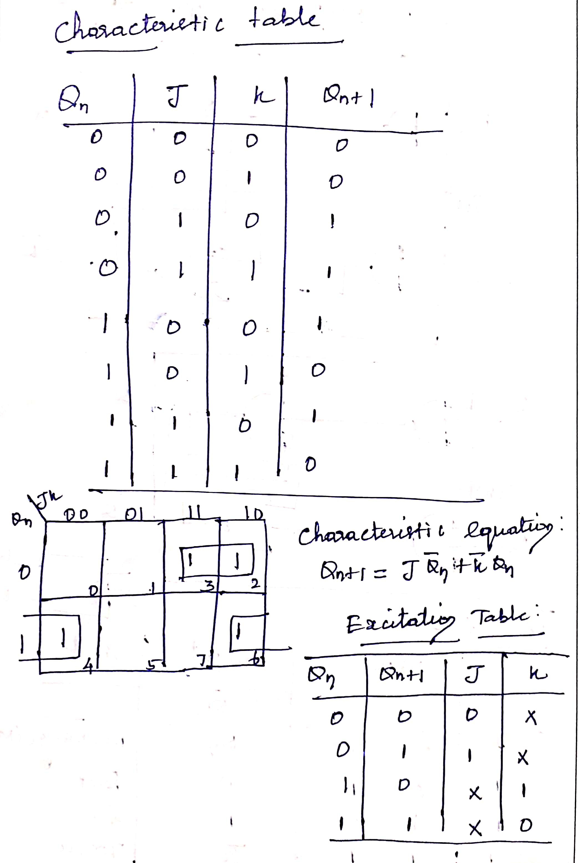

Slide 21
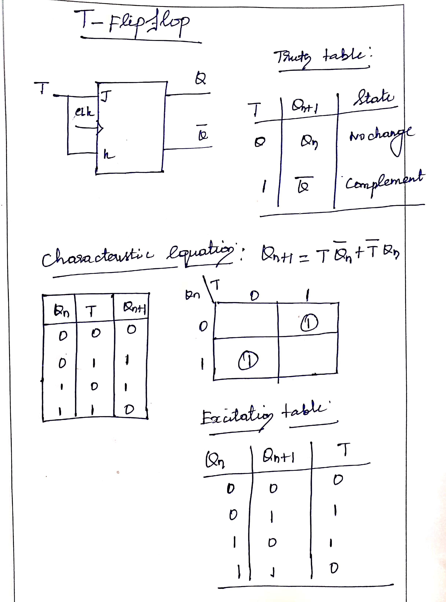

Slide 22
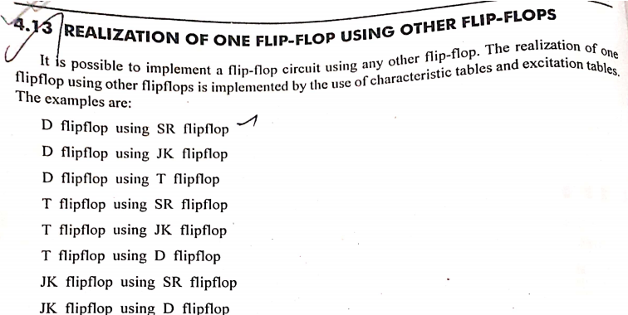
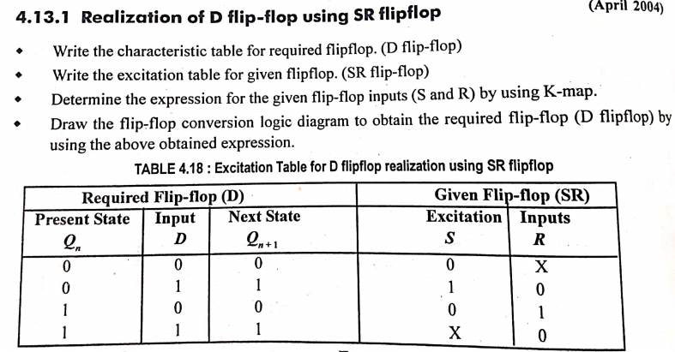

Slide 23
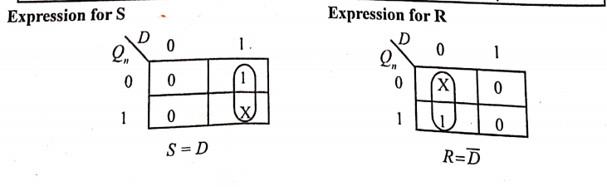
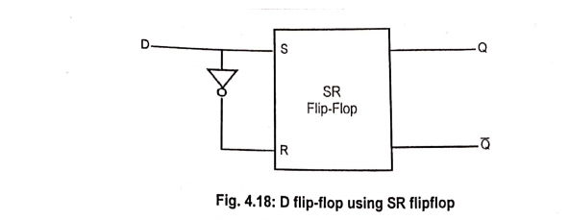

Slide 24
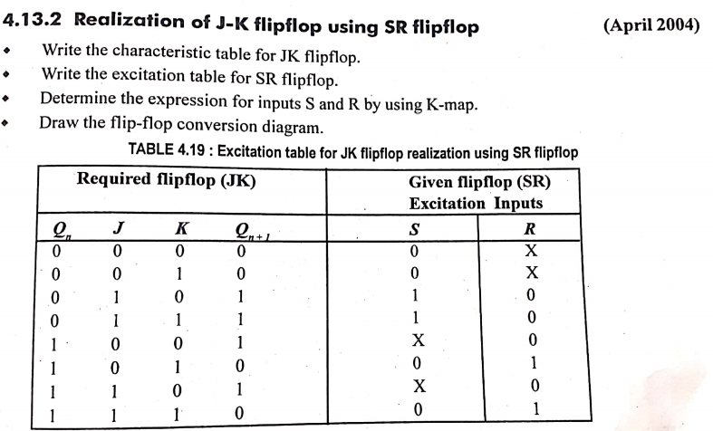
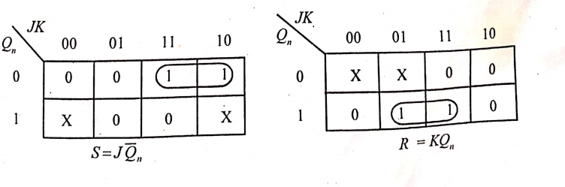

Slide 25
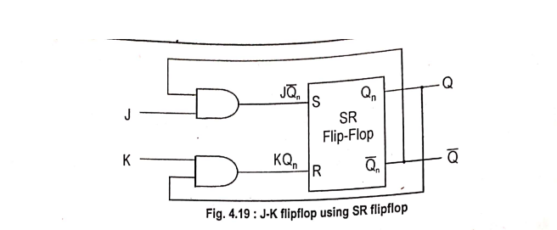
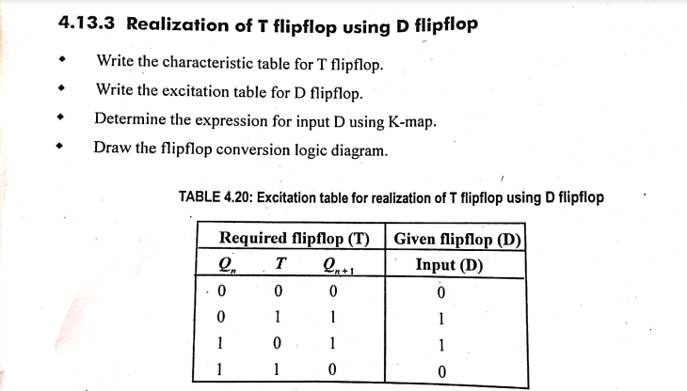

Slide 26
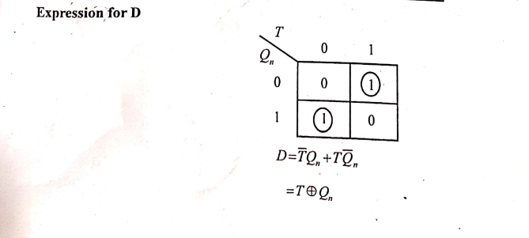
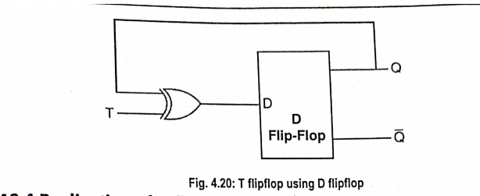

Slide 27
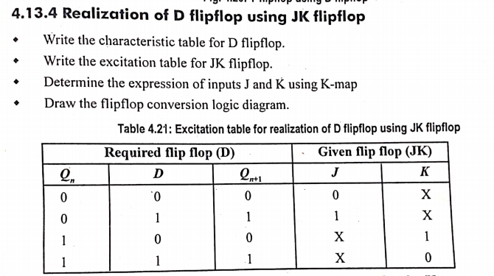
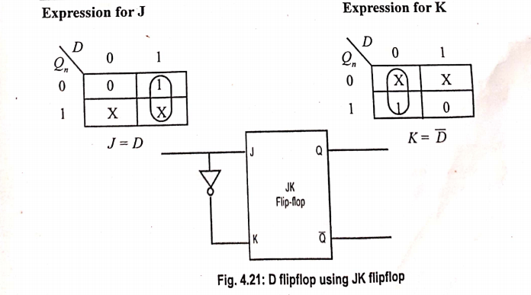

Slide 28
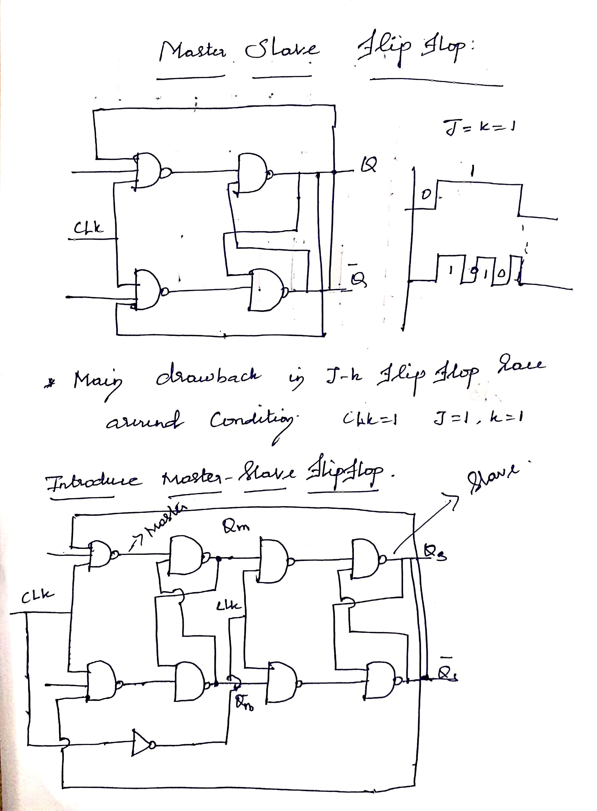

Slide 29
